Slide 1
“THE PERCEPTION PROCESS”
Communication and Presentation Skills
Department of Computer Science
FAST NU Peshawar
Lecture by Ms. Maryam Ali Khan

Slide 2
A young couple, Lisa and John, moved into a new neighborhood. One morning while they were eating breakfast, Lisa looked out the window and watched her next-door neighbor hanging out her washed clothes.
“That laundry’s not clean!” Lisa exclaimed. “Our neighbor doesn’t know how to get clothes clean!”
John looked on but remained silent.
Every time her neighbor would hang her wash to dry, Lisa would make the same comments.
A few weeks later Lisa was surprised to glance out her window and see a nice, clean wash hanging in her neighbor’s yard. She said to her husband, “Look, John﻿—she’s finally learned how to wash correctly! I wonder how she did it.”
John replied, “Well, I have the answer for you. You’ll be interested to know that I got up early this morning and washed our windows!”

Slide 3
IS PERCEPTION THE SAME AS REALITY?

Slide 4
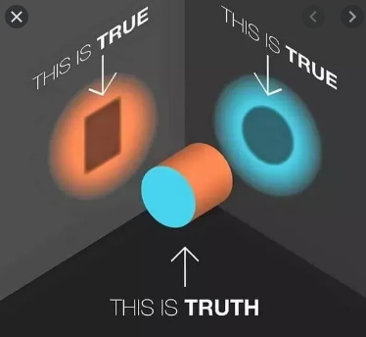

Slide 5
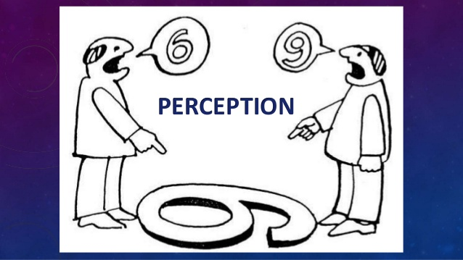

Slide 6
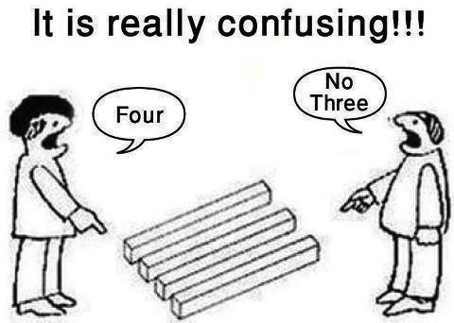

Slide 7
Ever said
“LOOK AT IT FROM MY PERSPECTIVE”?

Slide 8
WHAT IS PERCEPTION?
The lens through which we see reality
The process of gathering sensory information and assigning meaning to it

Slide 9
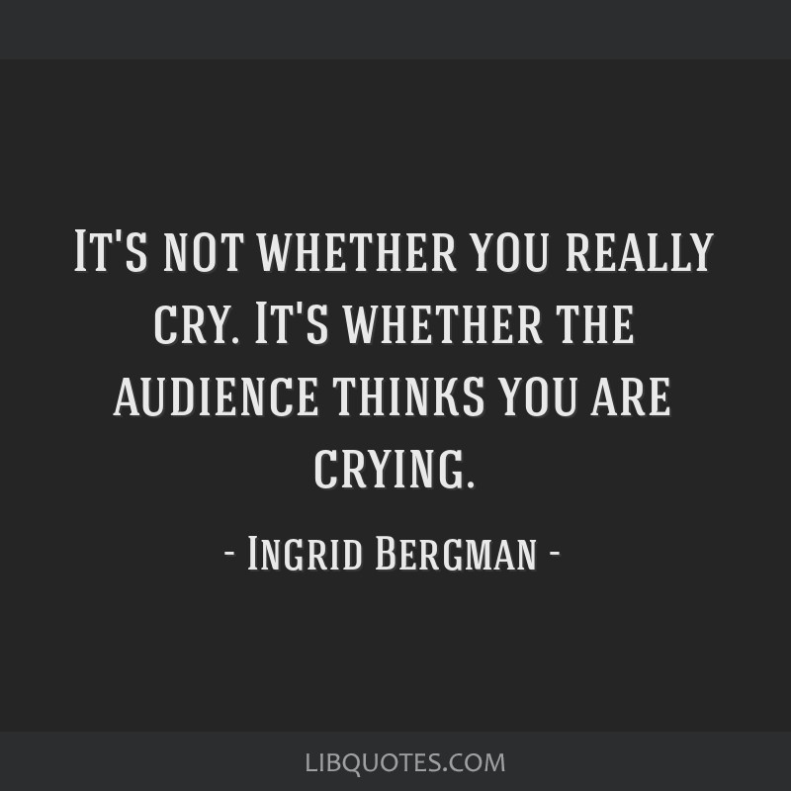

Slide 10
THE PERCEPTION PROCESS
The process of selectively attending and assigning meaning to information
At times, our perception of the world, other people, and ourselves agree with the perception of others. At other times, it does not agree.

Slide 11
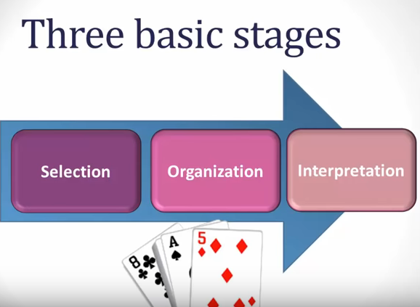

Slide 12
PERCEPTION IS BASED ON:
Selection
  Needs
  Interests
  Expectations
Organization
  Simplicity
  Pattern
Interpretation
Dual Processing

Slide 13
1. SELECTION
Exposed to stream of sensory stimuli
Attention focused on little of it
Out of so many channels, only a few are considered based on our needs, interests and expectations
We cant focus on everything
We pay attention to certain things while others go unnoticed
Attention acts like a spotlight

Slide 14
Imagine that you are at a party for a friend hosted at a bustling restaurant. Multiple conversations, the clinking of plates and forks, and many other sounds compete for your attention. Out of all these noises, you find yourself able to tune out the irrelevant sounds and focus on the amusing story that your dinner partner shares.

Slide 15
A college professors perception of an appropriate work attire is slightly different from the perception of an appropriate work attire of a banker

Slide 16
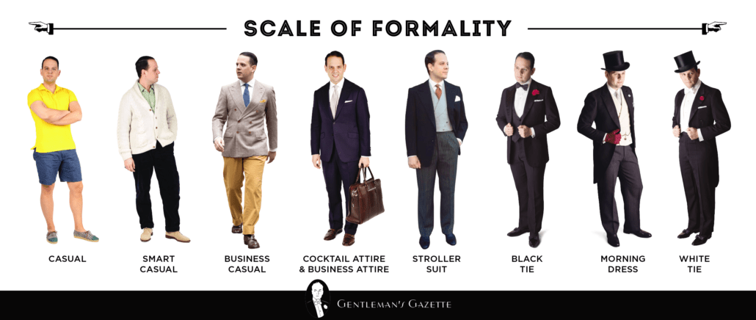

Slide 17
A. NEEDS
Paying attention according to our biological and psychological needs
A poor man thinks about food and shelter
A rich man thinks about luxuries of life
A tired man thinks about finding a place to sleep

Slide 18
B. INTERESTS
Paying attention according to our interest
Imagine that you are at a party for a friend hosted at a bustling restaurant. Multiple conversations, the clinking of plates and forks, and many other sounds compete for your attention. Out of all these noises, you find yourself able to tune out the irrelevant sounds and focus on the amusing story that your dinner partner shares.

Slide 19
C. EXPECTATIONS
Play a strong role in determining the way we see the world
We are likely to see what we expect and miss what violates our expectations
People who are warned that they are about to taste something bad rate what they do taste more negatively than people who are told that the taste won’t be so bad

Slide 20
2. ORGANIZATION
Through the process of attention and selection we reduce the number of stimuli
Our brain organizes these stimuli using the principles of simplicity and pattern

Slide 21
A. SIMPLICITY
The brain simplifies a complex stimuli
Based on what someone is wearing, how she is standing, the expression on her face, we may perceive that person as a business executive, a doctor or a house wife

Slide 22
B. PATTERN
Our brain organizes the stimuli into patterns for better understanding
A crowd of people may be perceived as:
  Gender: men and women
  Age: Young or old

Slide 23

6 LINES OR 3 SETS OF LINES?

Slide 24
3. INTERPRETATION
The brain not only selects and organizes information but also assigns meaning to it. Look at the following:
  A. 0333 123457
  B. 19 0089
  C. 4632 7365 2596 2174
If you are used to seeing similar sets then you will interpret A as a telephone number, B as a roll number and C as a credit card number.

Slide 25
4. DUAL PROCESSING
Automatic Processing
Conscious Processing

Slide 26
A. AUTOMATIC PROCESSING
Do you ever tell yourself, “Hey, I don’t go through all of these steps. I just automatically understand what is going on.”
If yes, then this is automatic processing
Automatic processing uses heuristics(short-cut rules of thumb for understanding how to perceive something based on past experience.

Slide 27
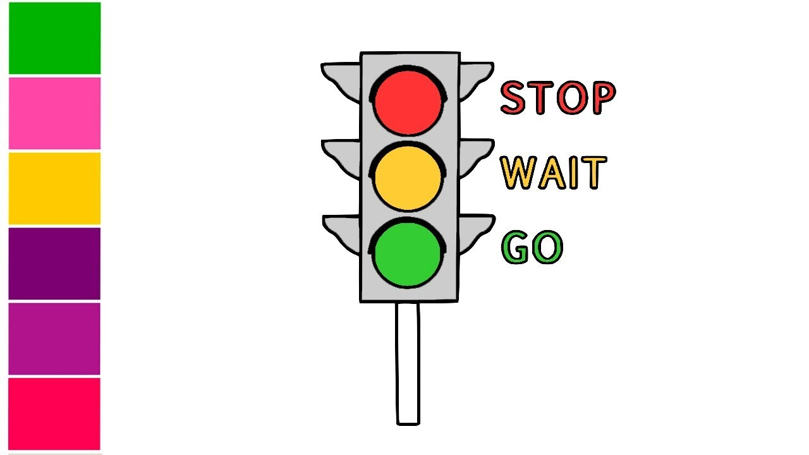
Why do we stop at the red light signal?
What about the green light?
  You unconsciously take your foot off the brake at the green signal

Slide 28
B. CONSCIOUS PROCESSING
Encountering things that are out of our past experience
How do we perceive something we have not done before?
Remember when you were first learning to drive?

